Slide 1
Expression Tree

Slide 2
An application of binary trees:
Binary Expression Trees

Slide 3
A Binary Expression Tree is . . .
A special kind of binary tree in which:
1. Each leaf node contains a single operand
2. Each nonleaf node contains a single binary operator
3. The left and right subtrees of an operator node represent subexpressions that must be evaluated before applying the operator at the root of the subtree.

Slide 4
A Four-Level Binary Expression
‘*’
‘-’
‘/’
‘8’
‘5’
‘+’
‘3’
‘4’
‘2’

Slide 5
Levels Indicate Precedence
The levels of the nodes in the tree indicate their relative precedence of evaluation (we do not need parentheses to indicate precedence).
Operations at higher levels of the tree are evaluated later than those below them.
The operation at the root is always the last operation performed.

Slide 6
A Binary Expression Tree
‘*’
‘+’
‘3’
‘4’
‘2’
What value does it have?
( 4 + 2 ) * 3 = 18

Slide 7
Easy to generate the infix, prefix, postfix expressions (how?)
‘*’
‘-’
‘/’
‘8’
‘5’
‘+’
‘3’
‘4’
‘2’
Infix: ( ( 8 - 5 ) * ( ( 4 + 2 ) / 3 ) )
Prefix: * - 8 5 / + 4 2 3
Postfix: 8 5 - 4 2 + 3 / *

Slide 8
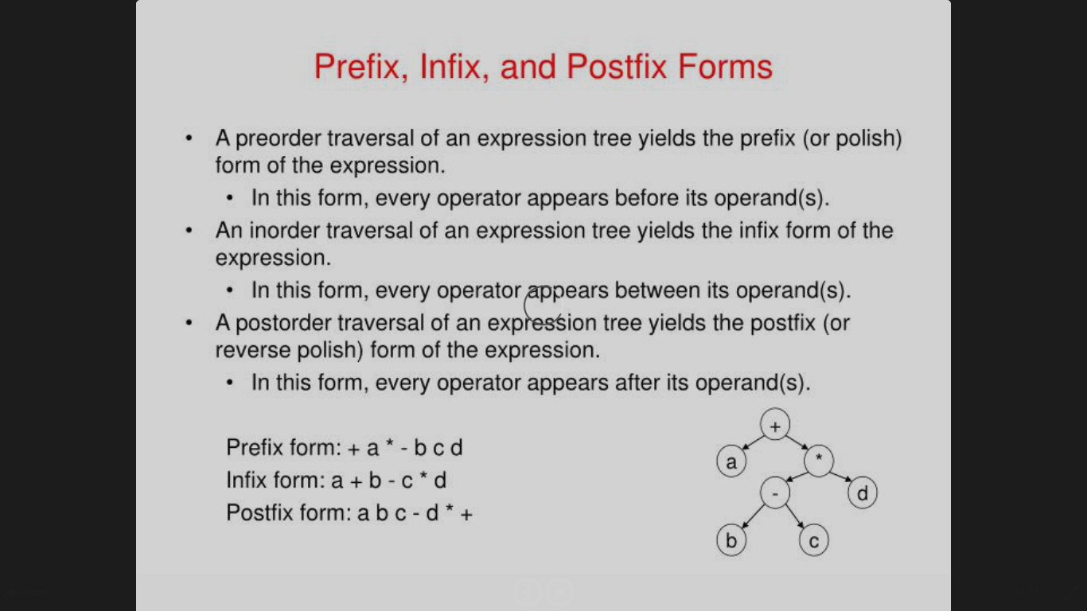

Slide 9
Inorder Traversal: (A + H) / (M - Y)
Print second
tree
‘/’
‘+’
‘-’
‘A’
‘H’
‘M’
‘Y’
Print left subtree first
Print right subtree last

Slide 10
Preorder Traversal: / + A H - M Y
Print first
tree
‘/’
‘+’
‘-’
‘A’
‘H’
‘M’
‘Y’
Print left subtree second
Print right subtree last

Slide 11
Postorder Traversal: A H + M Y - /
Print last
tree
‘/’
‘+’
‘-’
‘A’
‘H’
‘M’
‘Y’
Print left subtree first
Print right subtree second

Slide 12
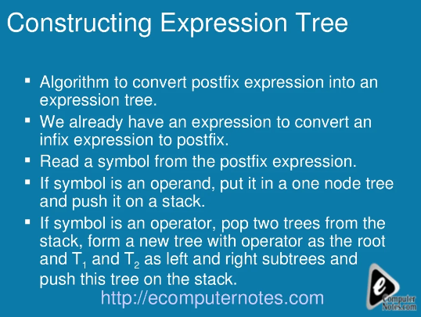

Slide 13
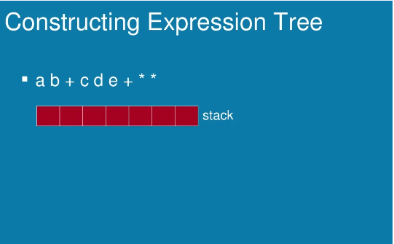

Slide 14
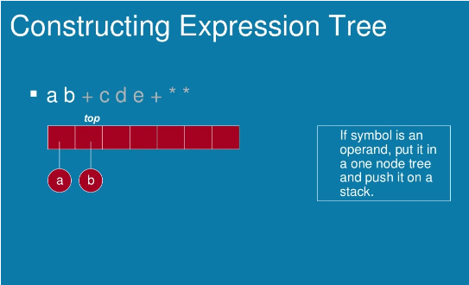

Slide 15
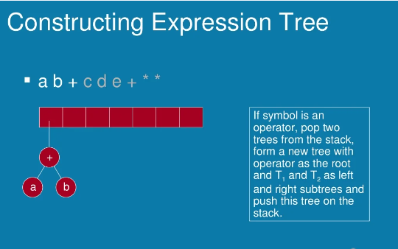

Slide 16
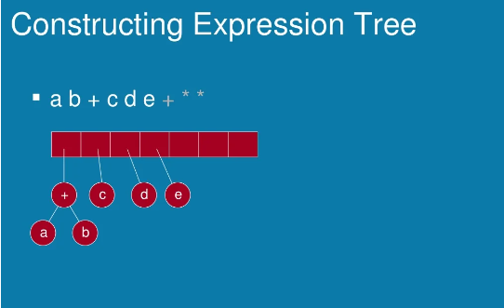

Slide 17
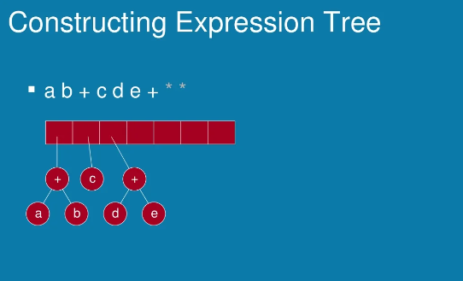

Slide 18
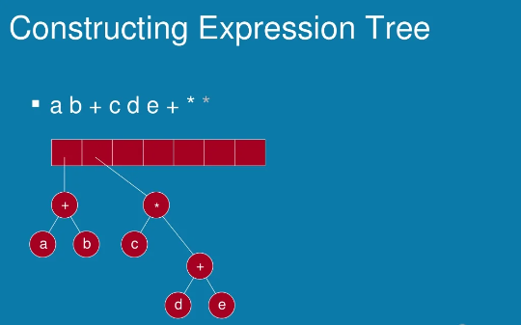

Slide 19
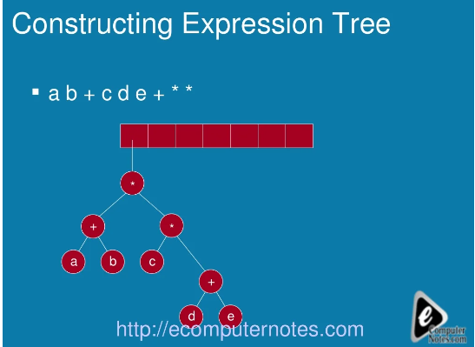

Slide 20
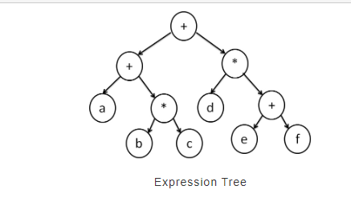
a + (b * c) + d * (e + f)

